Slide 1
Active House
VISHWAS MALHOTRA

Slide 2
Introduction
The Active House project is a complete home monitoring
system.
The idea is that you would have one Sensor Hub in each
room of your home to collect data and a Raspberry Pi
base station which all of the sensor hubs send their data to wirelessly.
The base station then sends the received sensor data to
the database for use in the app.

Slide 3
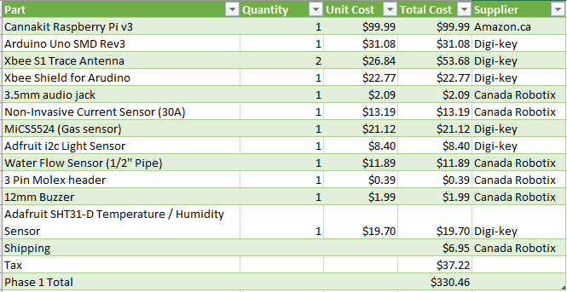
Budget

Slide 4
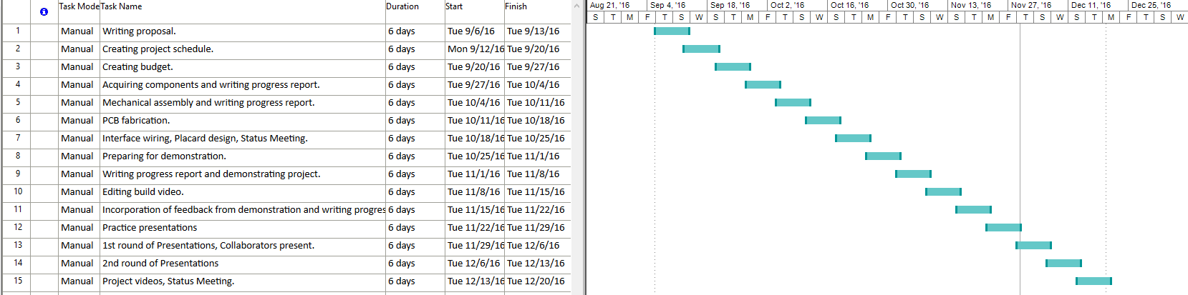
Project Schedule

Slide 5
Knowledge Used From Other Classes
Electronic Devices and Circuits – Soldering experience and circuit creation
Database with Java – Setting up and connecting to database
Electronic Circuits – Voltage Divider calculations
Technical Workplace Writing – Creating write-ups and technical drawings
Software Engineering – Creating and managing project schedules
Hardware Project – Combining all previous experiences in a fun project

Slide 6

Build Video

